Slide 1

Residual TG risk in CKD, why it still matter presentation by: dr. ng eng khim
(cvrm summit primary care 2026) summary by : dr. nurhayati binti mohd sobki upm health centre

Slide 2
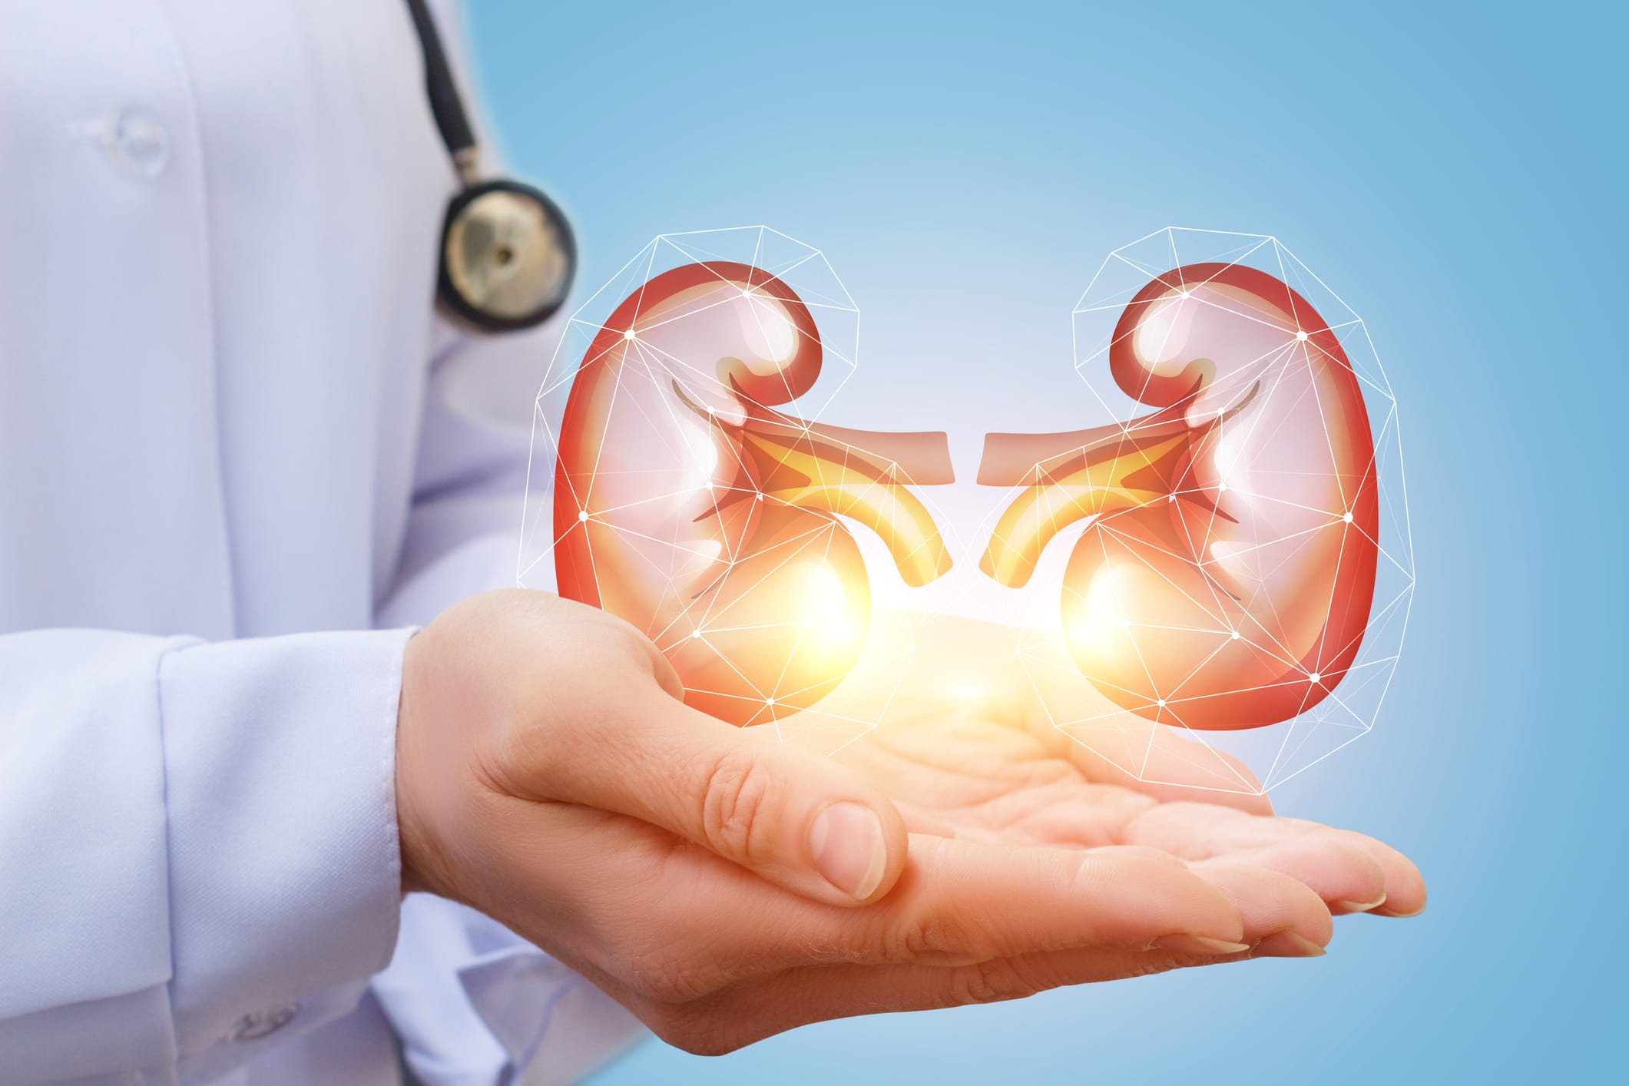
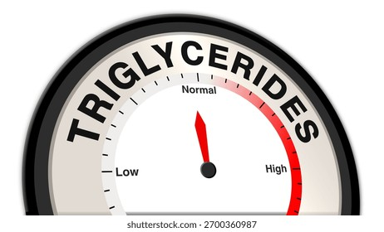
The nephrologist’s catch: treating lipids vs protecting kidneys
THE TREAT: ESRD DYSLIPIDAEMIA IS DRIVEN BY HYPERTRIGLYCERIDEMIA (TG) AND APO-III, DRASTICALLY INCREASING CARDIOVASCULAR MORBIDITY.
THE BARRIER : CONVENTIONAL FIBRATES (FINOFIBRATE/BEZAFIBRATE) ARE NOTORIUS FOR RENAL ACCUMULATION, PROMPTING CLINICAL INERTIA. PRESCRIBRES ARE FORCED TO CHOOSE BETWEEN CONTROLLING LIPIDS AND ACCELERATING RENAL DECLINE.
GUIDELINE ROADBLOCK: KDIGO GUIDELINESSPECIFICALLY RECOMMEND AGAINST THE ROUTINE USE OF FIBRATES IN THE CKD POPULATION DUE TI INCREASED RISK OF ADVERSE EVENTS, TRAPPING PRACTITIONERS IN CLINICAL INERTIA.

Slide 3
PEMAFIBRATE
PEMAFIBRATE: HIGHLY SELECTIVE PEROXISOME PROLIFERATOR- ACTIVATED RECEPTOR ALPHA (PPRα) MODULATOR.
IT RETAINS POTENT TRIGLYCERIDE-LOWERING CAPABILITIES WHILE ENTIRE BYPASSING THE PSYCHOLOGICAL PATHWAYS THAT TRIGGER LIVER ENZYME ELEVATION AND RENAL TOXICITY.
ITS ALSO UTILIZES A COMPLETELY DIFFERENT METABOLIC EXIT ROUTE. IT IS PRIMARILY METABOLIZED HEPATICALLY AND EXCRETED VIA BILE, ELIMINATING THE RISK OF RENAL ACCUMULATION
FROM THE COHORT STUDY BY IWASAKI: RETROSPECTIVESTUDY OF CKD WITH HYPERTRIGLYCERIDEMIA SWITCHED FROM FINOFIBRATE/BEZAFIBRATE TO PEMAFIBRATE OVER 24 WEEKS SHOW THE eGFR AVERAGE IMPROVEMENT TILL +10.2 mL/min/1.73m2

Slide 4
conclusion
TREAT WITH CONFIDENCE- HYPERTRIGLYCERIDEMIA IN CKD CAN FINALLY BE TREATED. PEMAFIBRATE BREAKS THE CLINICAL INERTIA BY BYPASSING RENAL CLEARANCE
SWITCH TO RESTORE- TRANSITIONING PATIENTS FROM CONVERTIONAL FIBRATES TO PEMAFIBRATES ACTIVELY REVERSE IATROGENIC DAMAGE, RESTORING eGFR by 10% AND STABILIZING sCr.
PROTECT THE HEART- ACTIVE SPPARMα OFFERS CARDIOVASCULAR PROTECTION, REDUCING MACE RISK BY 27% IN HIGHLY VULNERABLE CKD POPULATION
PEMAFIBRATE ESTABLISHES AN UNCOMPROMISING STANDARD OF CARE FOR ATHEROGENIC DYSLIPIDAEMIA IN HIGH-RISK CKD PATIENTS

